Slide 1




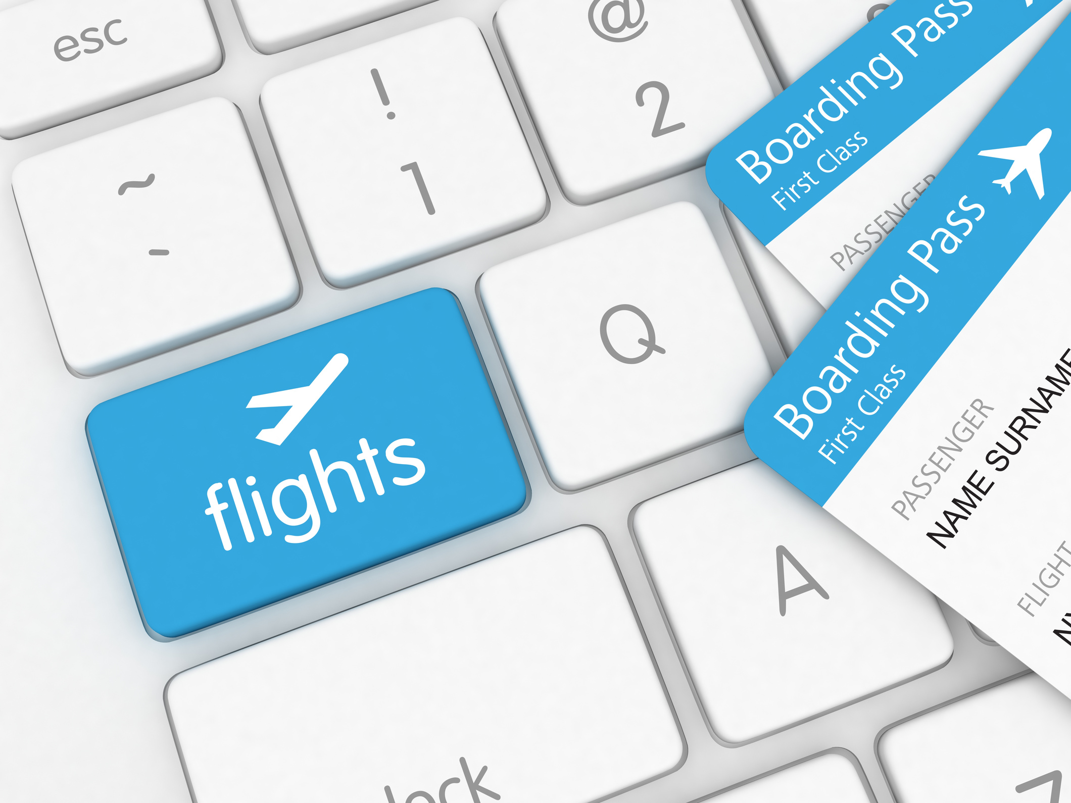





GROUP 8
SKY-LEVEL SATISFACTION
ANALYZING KEY DRIVERS OF
AIRLINE PASSENGER SATISFACTION
MBAI 5300G
Date: NOV 21, 2025

Slide 2



GROUP 8
John de Guzman
Elaine Bhel Lagman
Renee Rae Santos
Hazal Turken

Slide 3


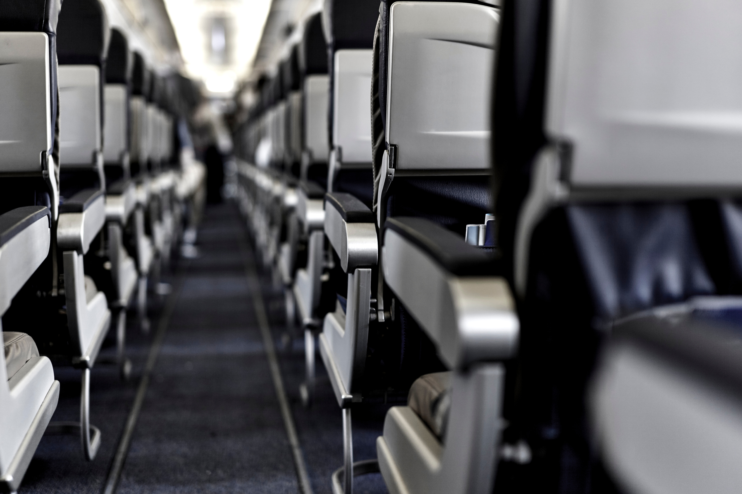


Content
Introduction
Dataset Summary
Feature Engineering
Data Analysis
Data Exploration
Feature Importance
Conclusion
Recommendation
References

Slide 4
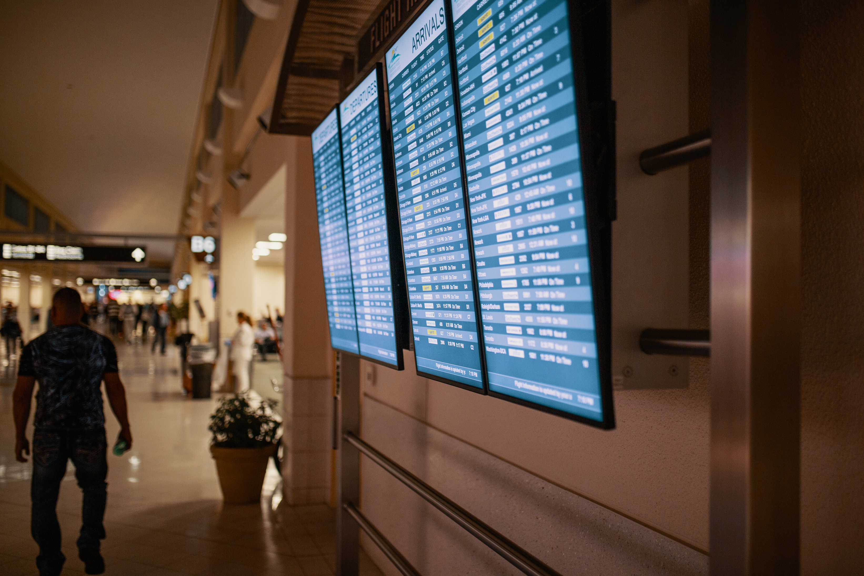





Introduction
The Canadian airlines industry recorded CAD 23.8 billion in revenue in 2023
Air Canada and WestJet are the dominant carriers in Canada
Newer / smaller carriers like Porter and Flair are gaining market share
As of 2025, Porter has about 9.3% of domestic weekly seat capacity (according to CAPA data) — showing non-“big two” carriers are increasingly relevant

Slide 5

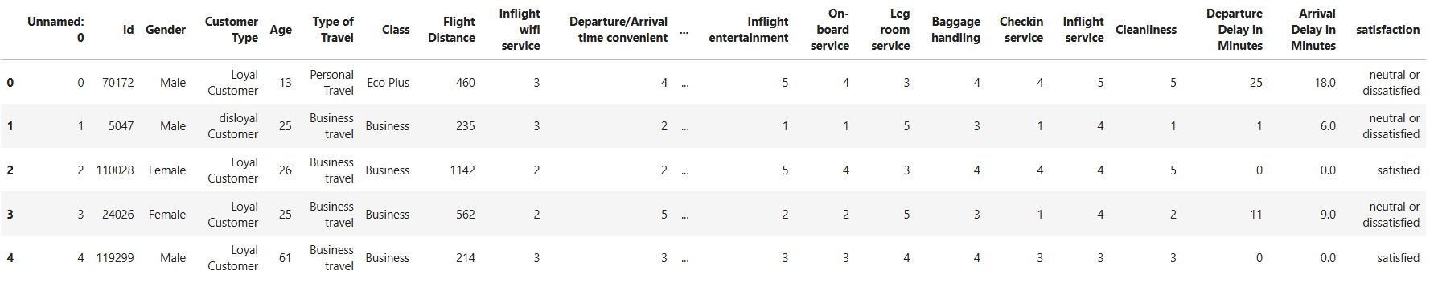

Methodology
Dataset Summary
The dataset consists of Airline Passenger Satisfaction Survey
Survey data comprises of 103904 responses and 25 columns
Data spans from customer segmentation and service area responses - rated 0-5 having 5 as the highest rating

Slide 6
Methodology
Data Cleaning and Basic Inspection
Missing Values in Arrival Delay is filled with the median
All responses are unique
Unnamed Column removed
Neutral or Dissatisfied is treated as Dissatisfied for this analysis

Slide 7
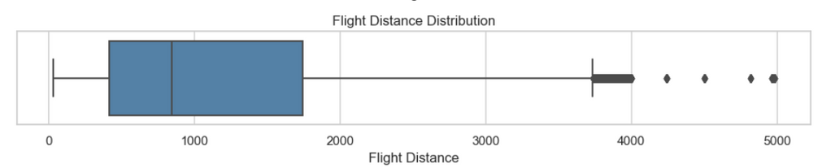
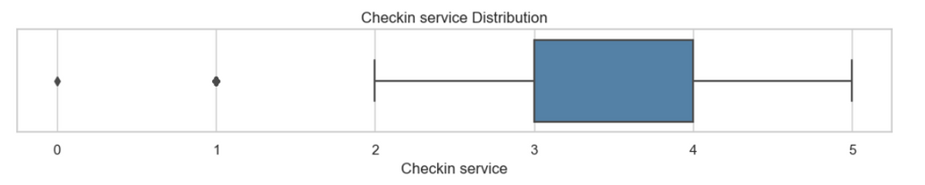
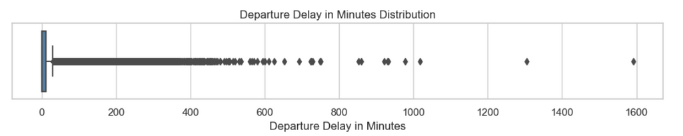
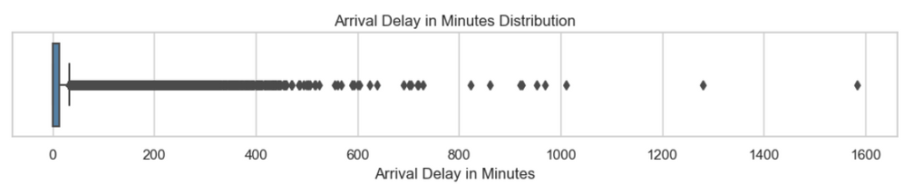
Methodology
Data Cleaning and Basic Inspection
Outlier Inspection:
Valid Data
Valid Data
Valid Data
Valid Data

Slide 8

Methodology
Feature Engineering
DISTANCE Categories
AGE Categories
No delay
Short delay (<30 min)
Medium delay (30-59 min)
Long delay (1-2 hours)
Very long delay (>2 hours)
0- 18
19-30
31-45
46-60
Above 60
DELAY in MINUTES Categories
CLASS Categories (with Order)
Short (<500 km)
Medium (500-1500 km)
Long (1501-3000 km)
Very long (>3000 km)
Eco
Eco Plus
Business

Slide 9
Data Analysis
Outline
Data Distribution
Numerical Distribution:
Age
Flight Distance
Departure Delay
Arrival Delay
Total Delay
Satisfaction Distribution
Passenger Characteristics Analysis
Satisfaction by Passenger Characteristics
Gender
Customer Type
Type of Travel
Cabin Class
Combined Characteristics
Customer Type x Class
Travel Purpose x Class
Age Group
Satisfaction by Age Group
Age x Cabin Class
Operational Performance Analysis
Flight Delay
Flight Distance
Feature Importance
All Features
Customer Features
Service Features
By Class
By Customer Type

Slide 10
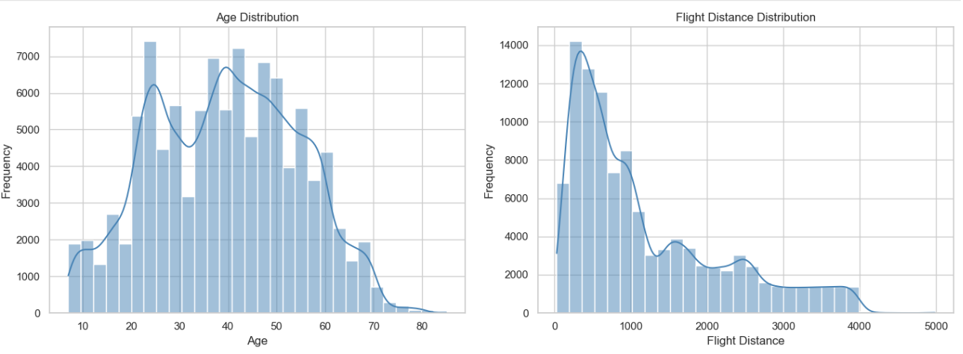
Data Analysis
A. Data Distribution
Numerical Distribution - Age, Flight Distance
Roughly normal, centered around working-age adults.
Most passengers fall between 25–50, shaping majority of satisfaction trends.
Dominated by short/medium flights
Very few long-haul flights
Right-Skewed due to few long-distance outliers.

Slide 11
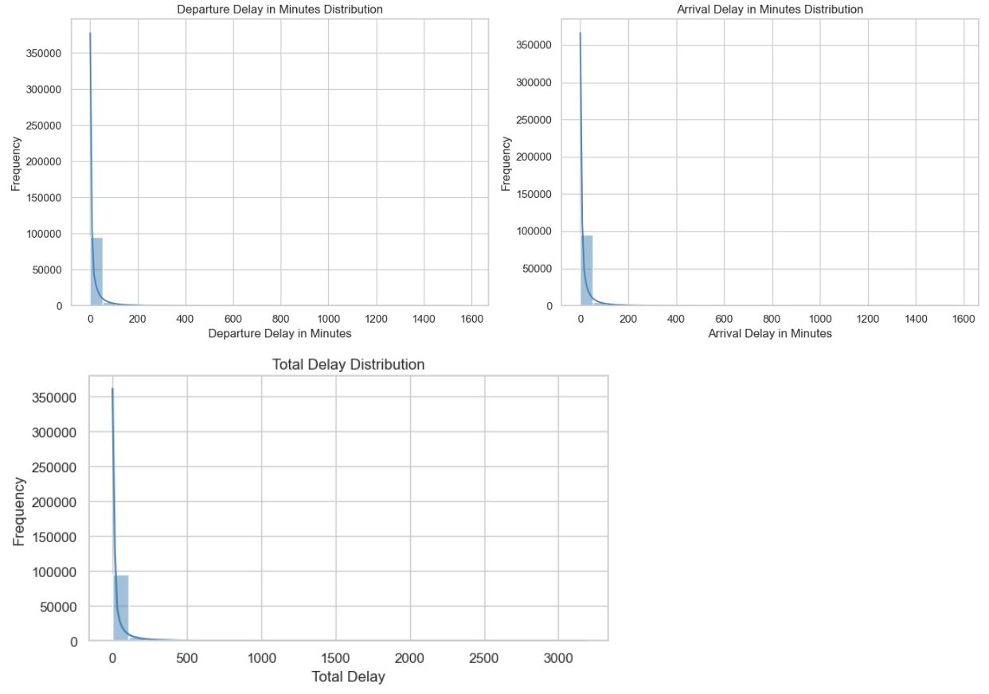
Data Analysis
A. Data Distribution
Numerical Distribution - Departure, Arrival, Total Delay
Strong right-skew → long delays are uncommon but extremely high when they occur.
Consistent pattern for departure, arrival, and total delay

Slide 12
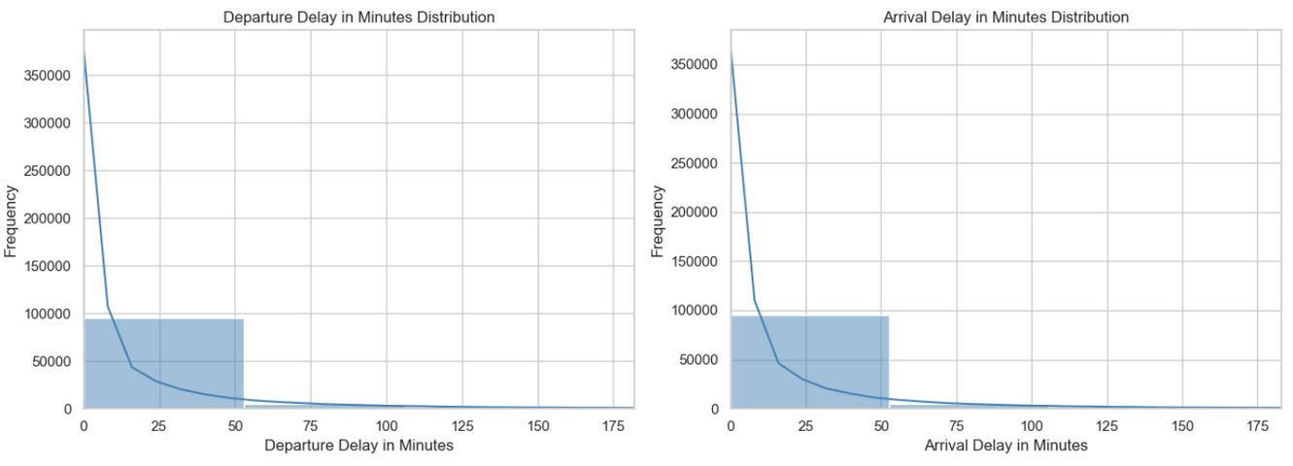
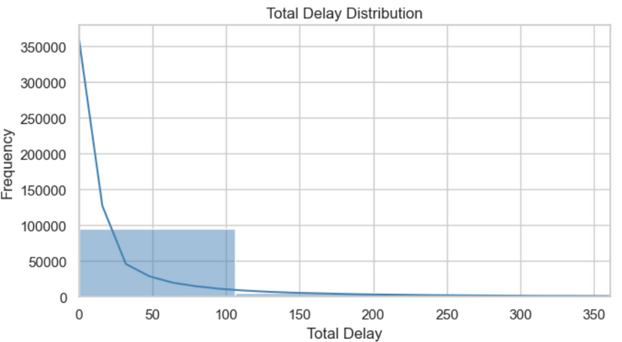
Data Analysis
A. Data Distribution
Numerical Distribution - Departure, Arrival, Total Delay (Zoomed )
Most delays fall under 50 minutes, confirming that disruptions are usually minor.
Delays cluster tightly in a low range, suggesting stable operational performance with only rare severe delays.

Slide 13
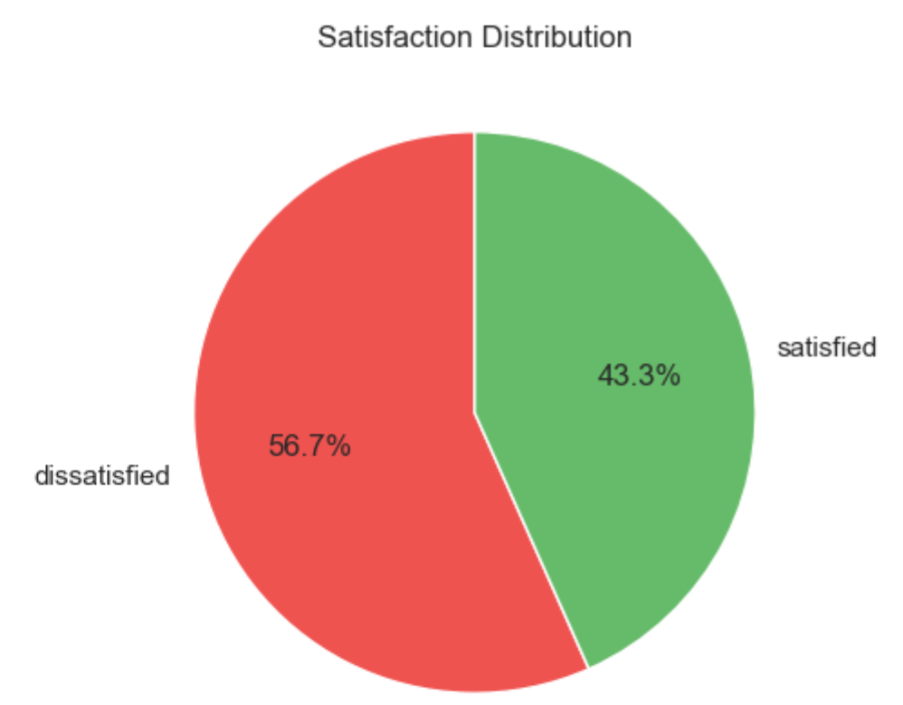
Data Analysis
A. Data Distribution
Target Variable
More passengers are dissatisfied than satisfied, suggesting that current service levels fall short of customer expectations.
The small gap between the two groups suggests customers have mixed experiences and are not consistently satisfied.

Slide 14
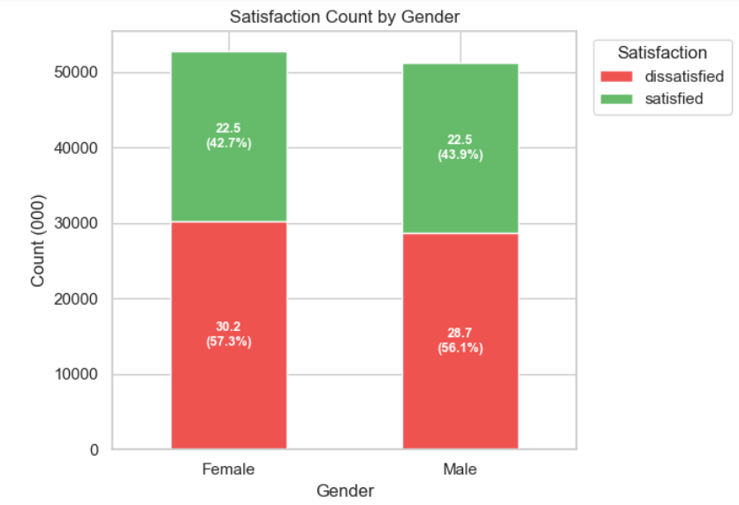
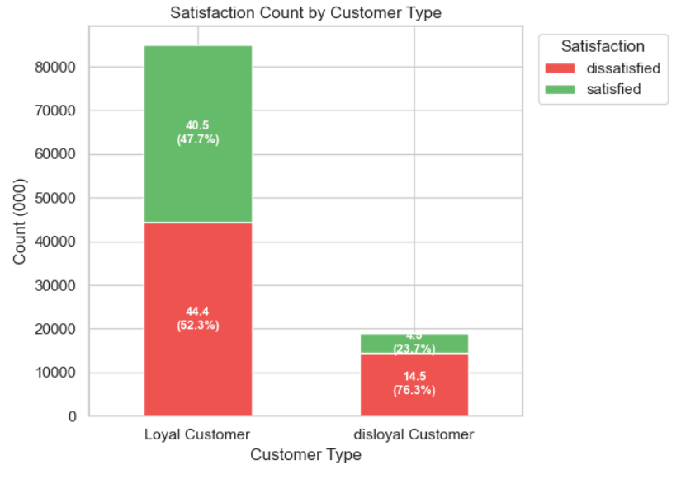
Data Analysis
B. Passenger Characteristics Analysis
Satisfaction by Gender & Customer Type
Gender shows minimal impact on satisfaction
Service issues affect all genders similarly
Loyal customers still show high dissatisfaction, meaning expectations aren’t met.
Disloyal customers are even more dissatisfied, suggesting weak first-time experience.

Slide 15
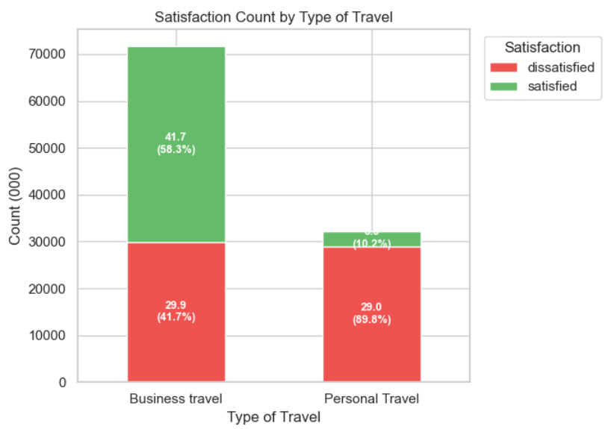
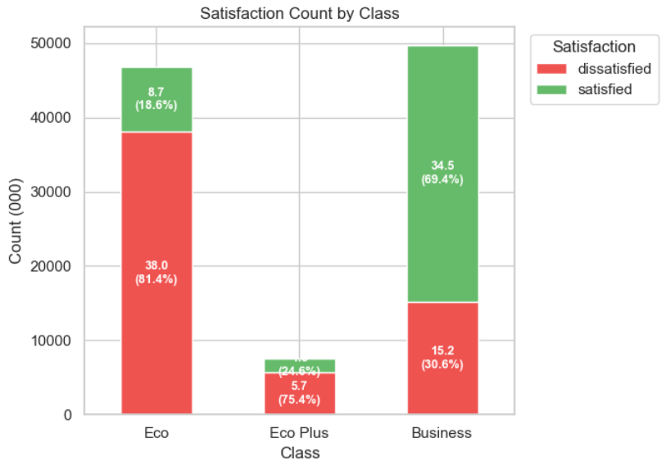
Data Analysis
B. Passenger Characteristics Analysis
Satisfaction by Type of Travel & Class
Business travelers show higher satisfaction, likely because services align better with their needs.
Personal travelers are less satisfied, suggesting their experience is less consistent.
Business class provides the strongest satisfaction, reflecting better service quality.
Economy and Eco Plus have higher dissatisfaction, pointing to service gaps in lower classes.

Slide 16
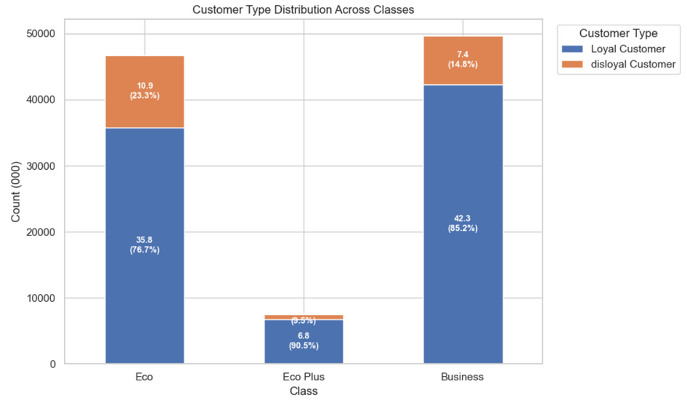
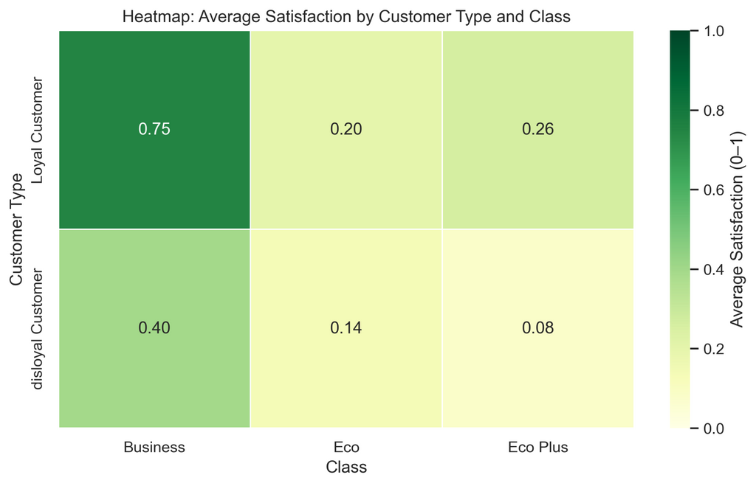
Data Analysis
B. Passenger Characteristics Analysis
Combined Characteristics: Customer Type x Class
Loyal customers are most satisfied in Business class, showing premium cabins deliver stronger service.
Disloyal customers in Economy show the lowest satisfaction, indicating weak first-time or occasional travel experiences.
Class has a stronger impact than loyalty, since both groups rate lower classes poorly but rate Business class higher.
Loyal customers improve satisfaction levels, but not enough to offset service gaps in Economy and Eco Plus.

Slide 17
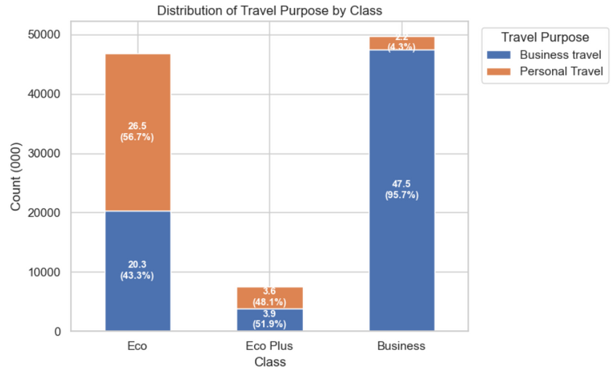
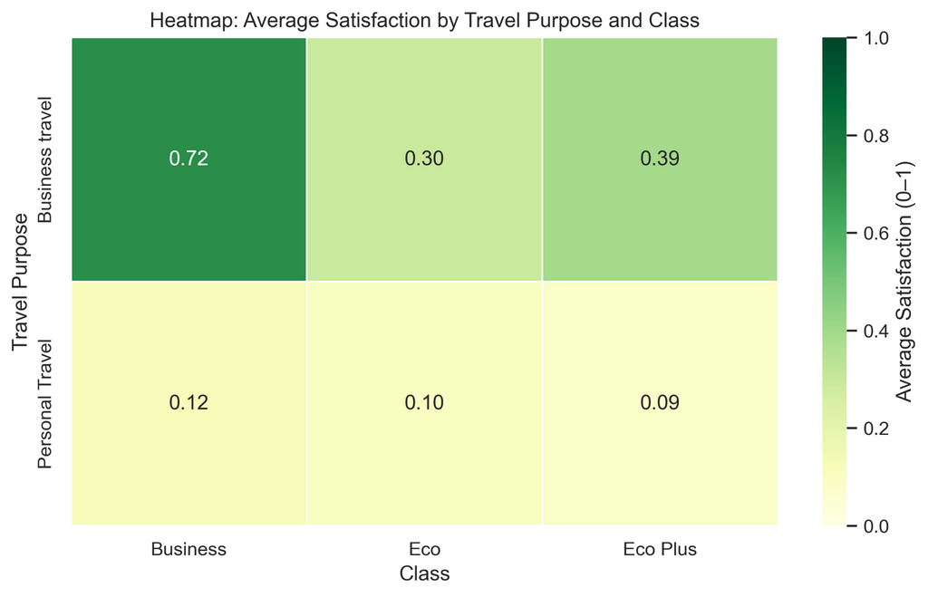
Data Analysis
B. Passenger Characteristics Analysis
Combined Characteristics: Travel Type x Class
Travelers prefer business class for work-related
Some travelers choose Eco whether for personal or work-related reasons
Eco-plus is rarely used for either travel reasons
Class is a strong indicator of satisfaction

Slide 18
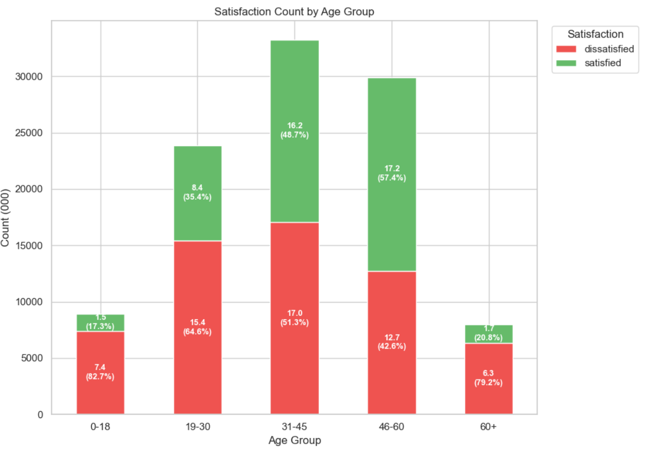
Data Analysis
B. Passenger Characteristics Analysis
Satisfaction by Age Group
While many people on ages 31-45 are both satisfied and dissatisfied, most people that are satisfied fall on ages 46-60

Slide 19
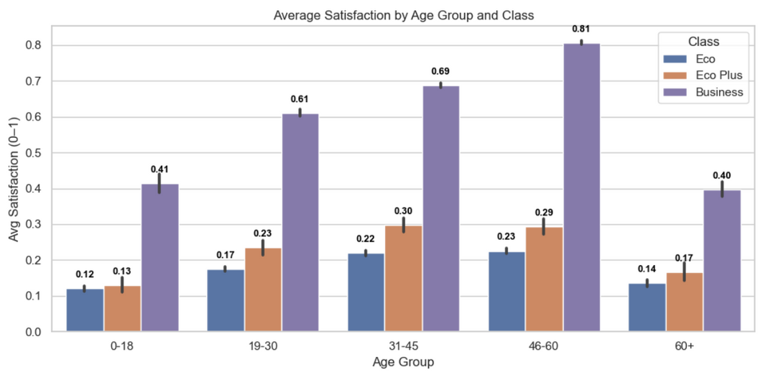
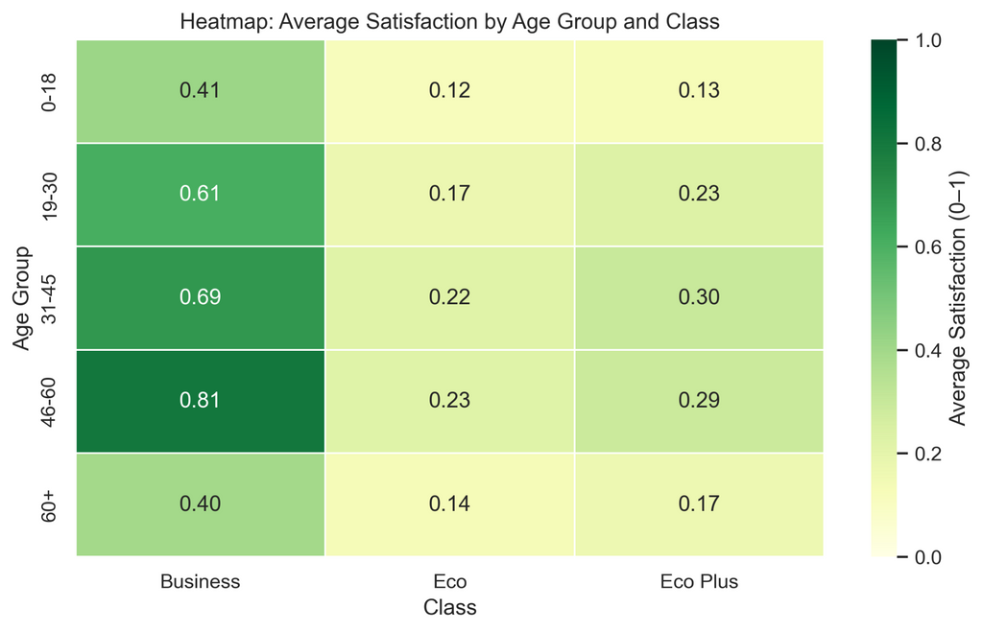
Data Analysis
B. Passenger Characteristics Analysis
Age × Cabin Class
46 - 60 flies more business class
31-45 and 46-60 flies more Eco Plus
46 - 60 proves to have a high average satisfaction score in the ‘Business class

Slide 20
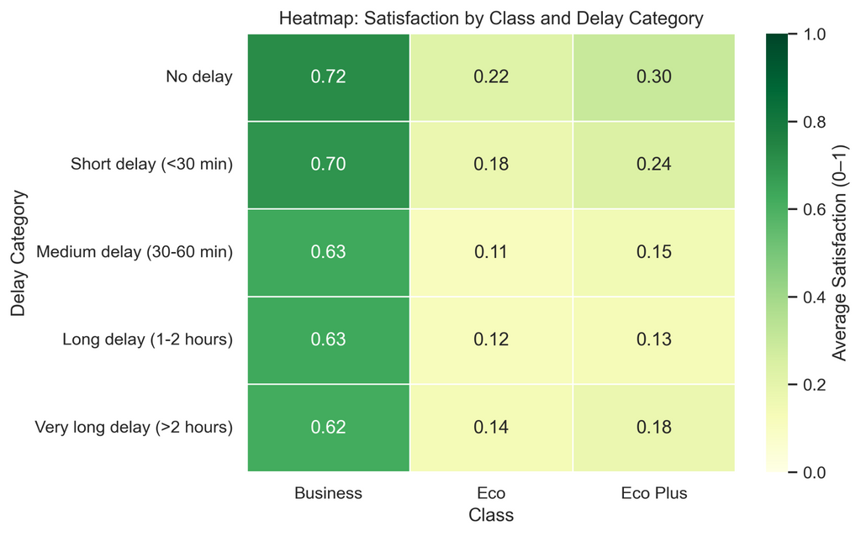
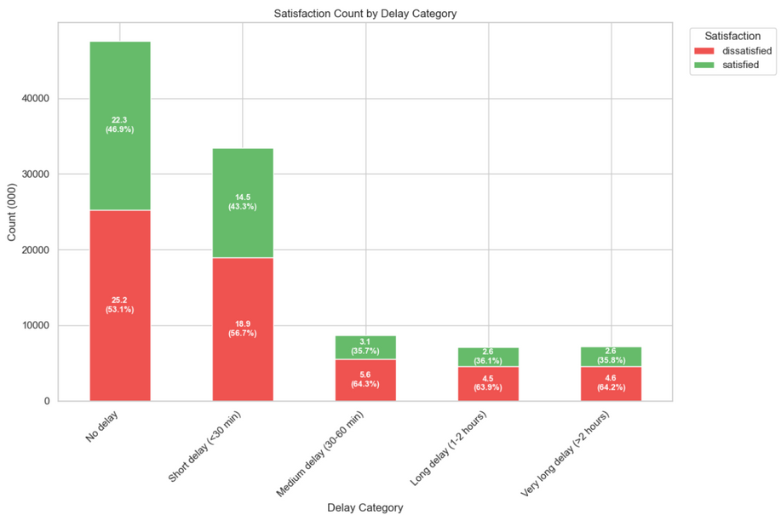
Data Analysis
C. Operational Performance Analysis
Delay Category
Delays above 30 minutes cause at least 64% dissatisfaction
People tend to be more satisfied if there are no delays

Slide 21
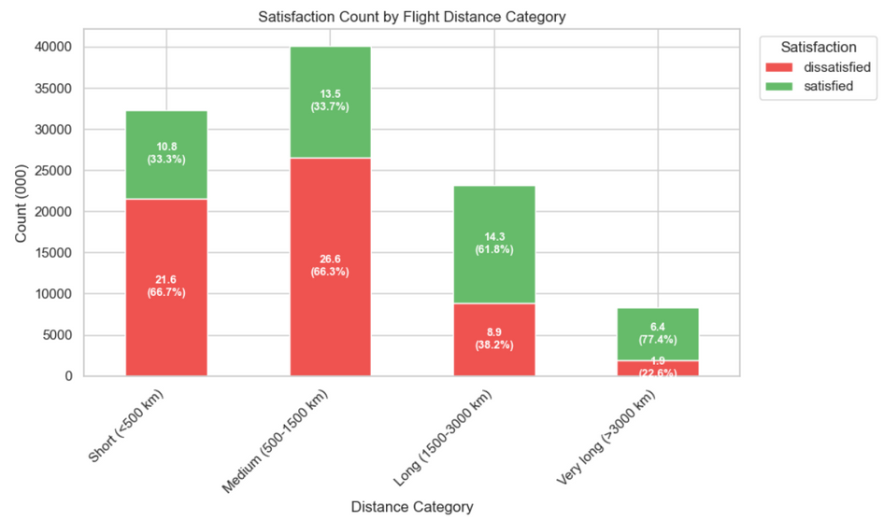
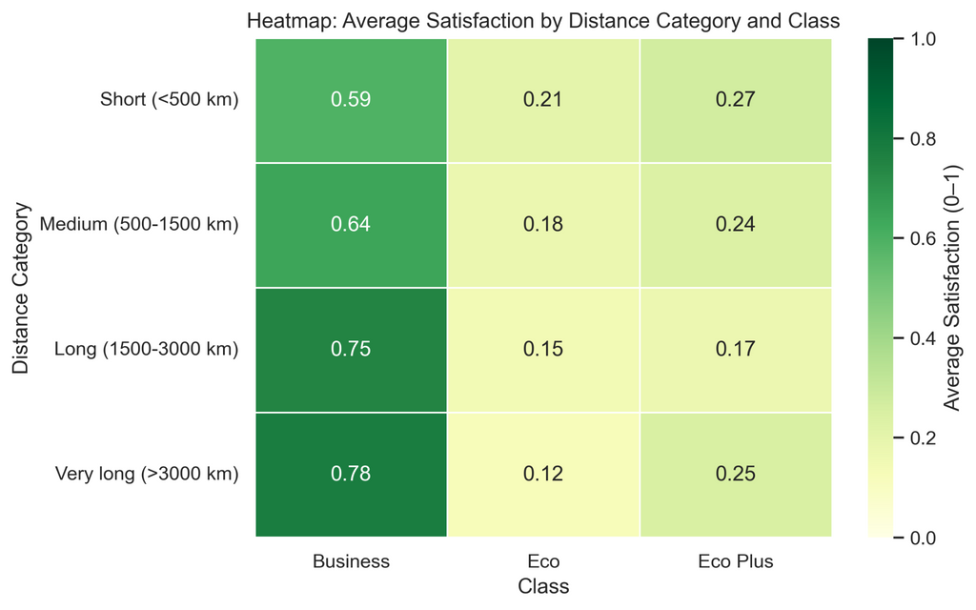
Data Analysis
C. Operational Performance Analysis
Flight Distance Analysis
The longer the distance, the higher the satisfaction
The shorter tends to be the most dissatisfied
Likely passengers flying long flights are in business class
Those who travel in Bus. Class tends to be more satisfied the longer they travel

Slide 22
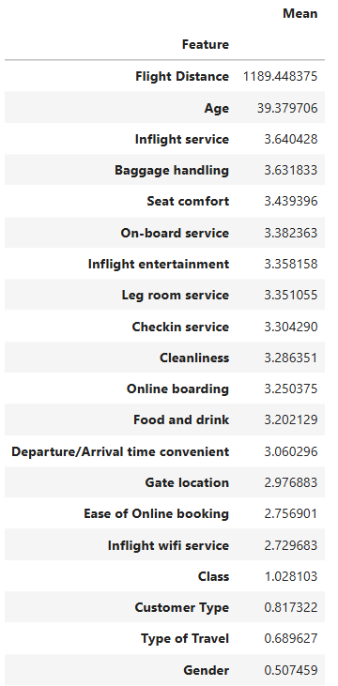
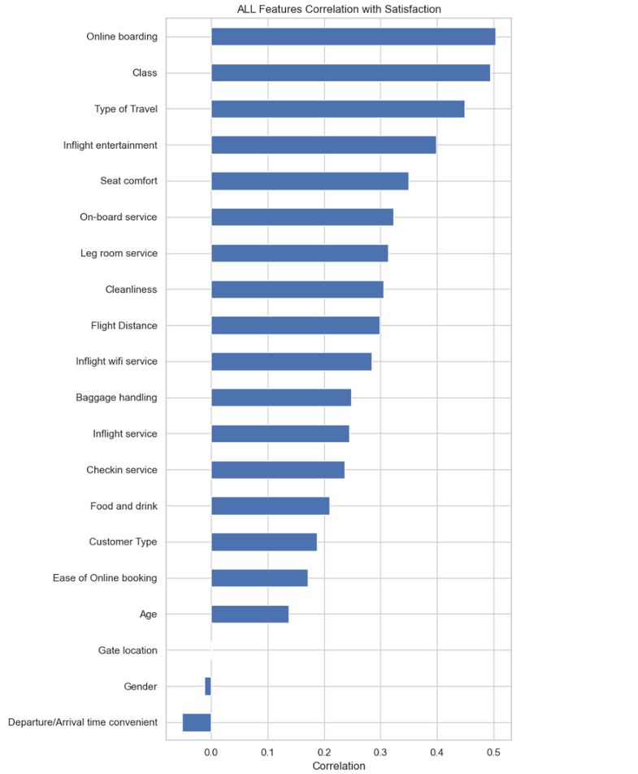
Data Analysis
Feature Importance for All Features
Online Boarding is the strongest positive driver of satisfaction.
Class & Type of Travel = major contributors
Gender & Gate location has almost no effect, indicating it is a low-priority improvement area
Departure/Arrival Time Convenience has negative correlation, meaning inconvenient schedules directly increase dissatisfaction

Slide 23
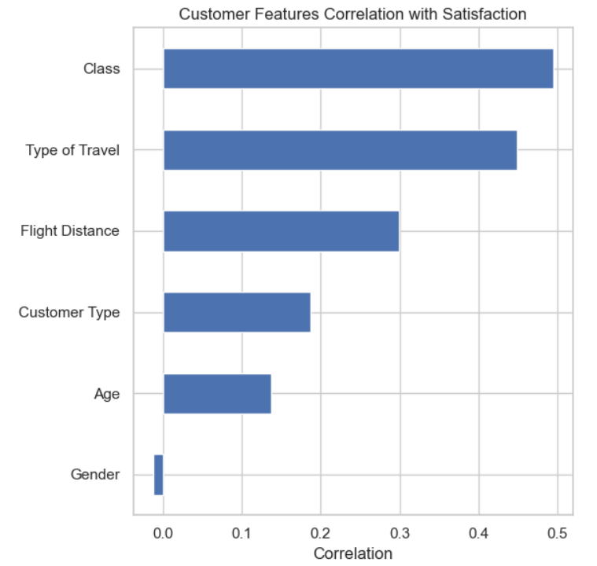
Data Analysis
Feature Importance for Customer Features
Class is the strongest driver → higher class = higher satisfaction
Type of Travel strongly affects satisfaction → business travelers are happier than personal travelers
Gender has almost no effect

Slide 24
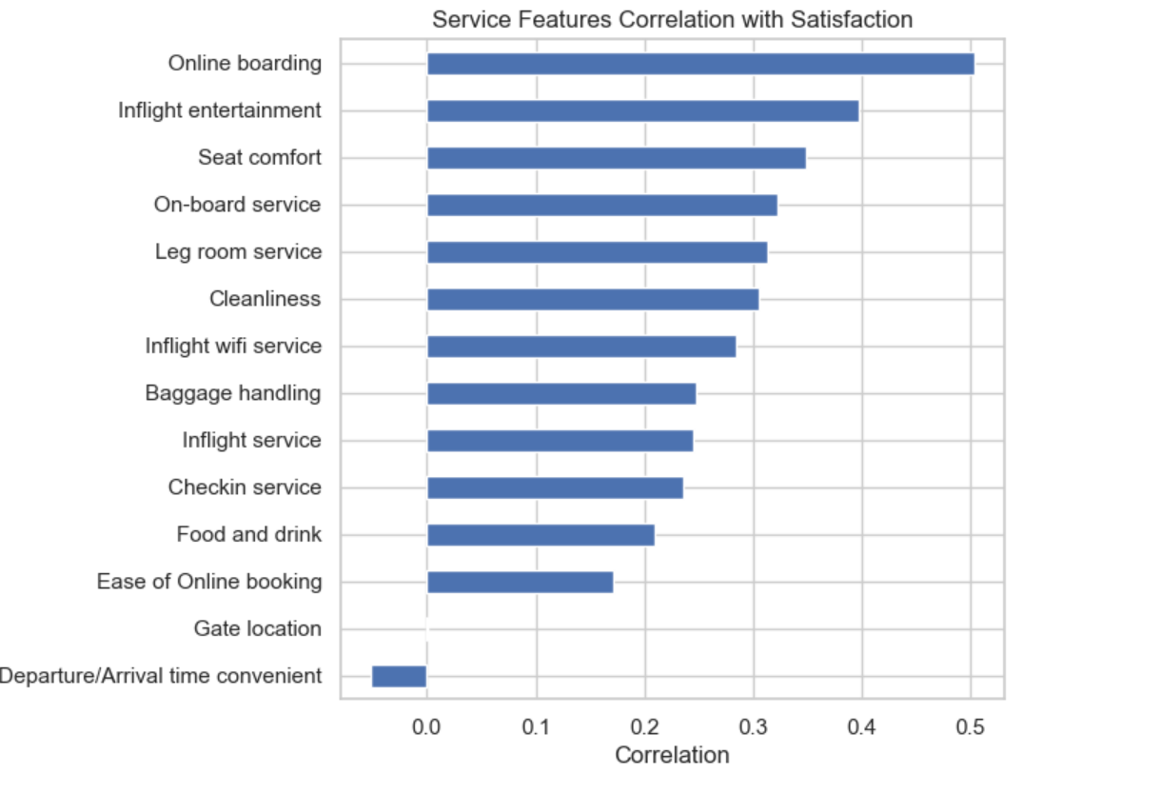
Data Analysis
Feature Importance for Service Features
Online boarding = top service driver
Inflight entertainment & seat comfort = strong improvements
Departure/arrival timing = dissatisfaction trigger if bad
Overall service score ≈ 3.24 / 5 → room for improvement

Slide 25
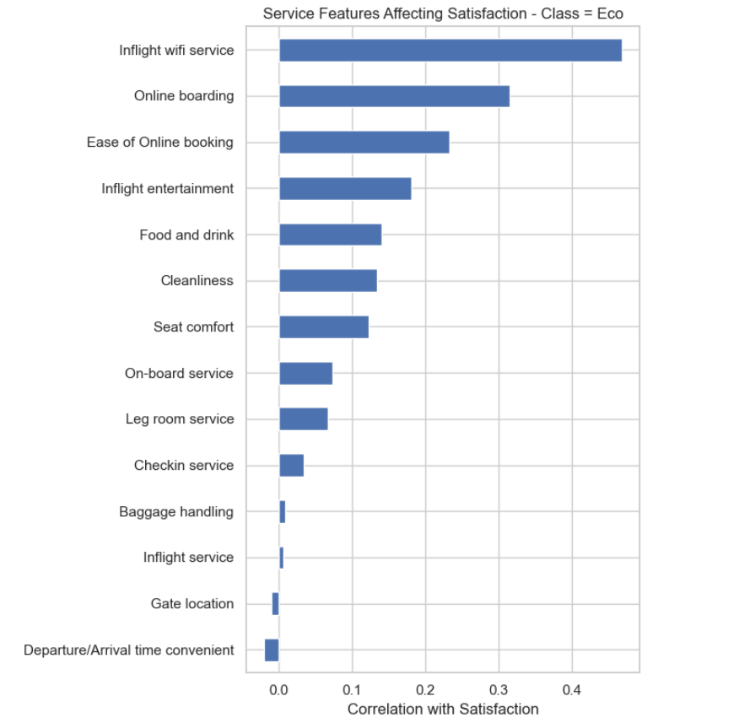
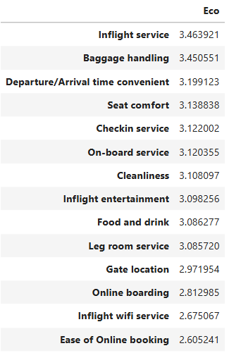
Data Analysis
Feature Importance by Class - Eco
Inflight Wi-Fi service is the strongest satisfaction driver, but its mean score is low.
Online boarding and ease of booking boost satisfaction, yet both have low means.
Departure/arrival convenience is negative → timing issues cause dissatisfaction.
Overall service means are moderate (mostly 3.0–3.4), reflecting neutral customer perception rather than strong satisfaction.

Slide 26
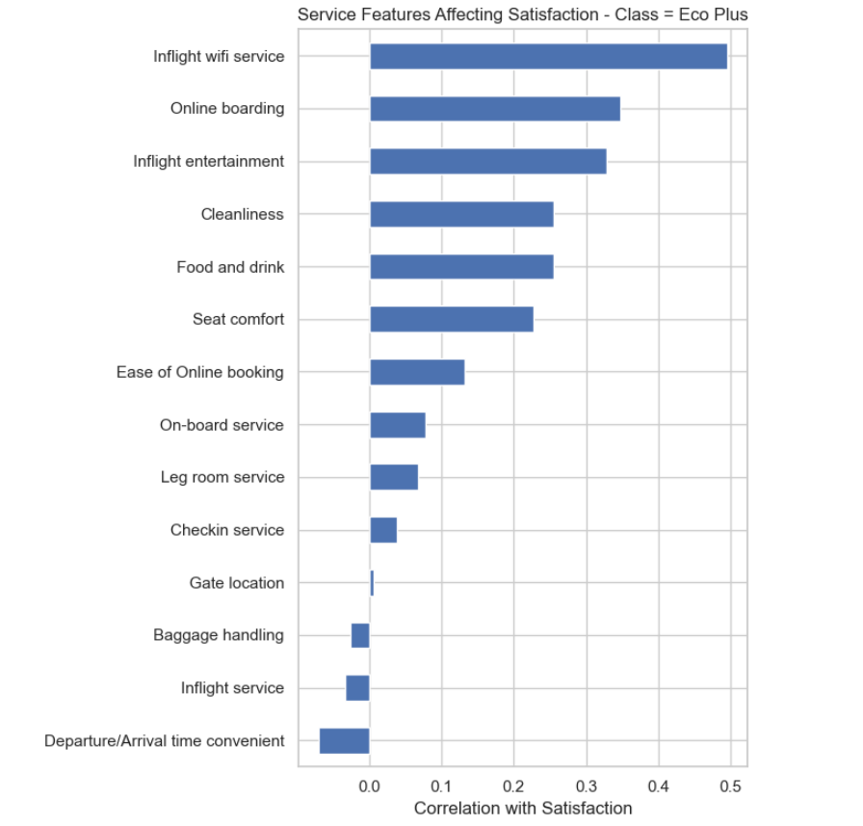
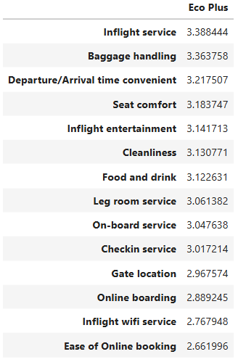
Data Analysis
Feature Importance by Class - Eco Plus
Inflight Wi-Fi is the top driver, but its mean score is low → biggest improvement need
Gate location and baggage handling show almost no effect
Departure/arrival convenience is negative, meaning timing issues reduce satisfaction

Slide 27
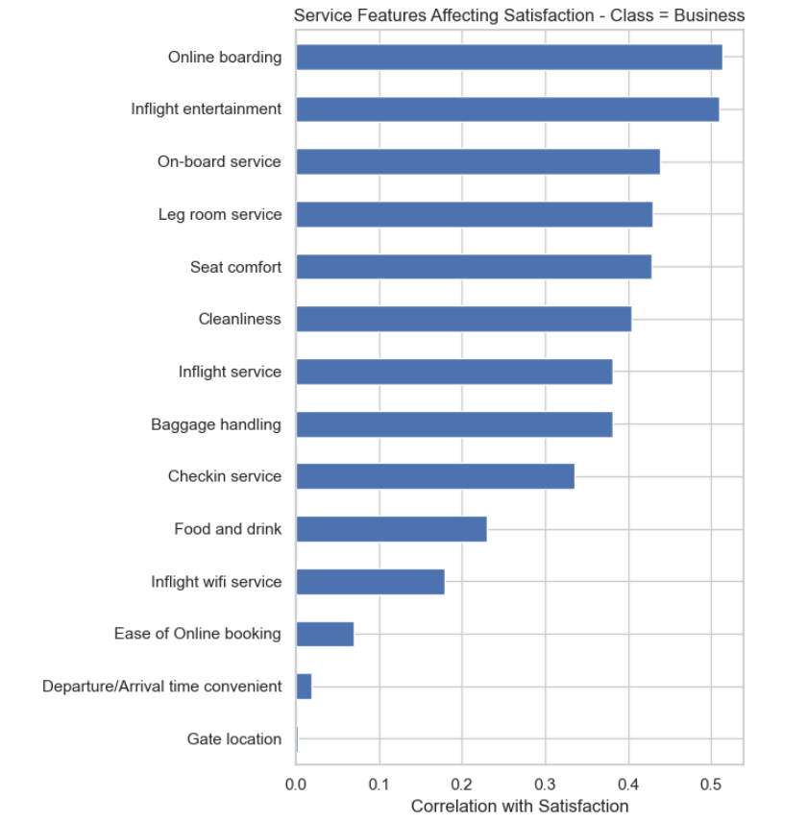
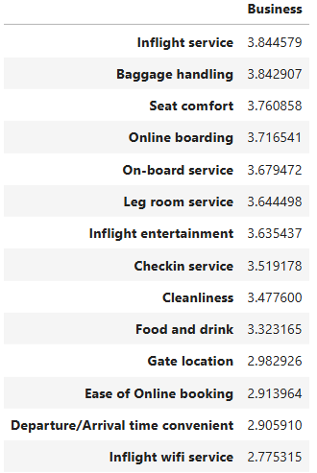
Data Analysis
Feature Importance by Class - Business
Online boarding & inflight entertainment → strongest drivers
Inflight Wi-Fi & online booking → low impact + low scores
Departure/arrival convenience & gate location → minimal effect
Business Class has no negatively correlated features because better service always leads to higher satisfaction

Slide 28
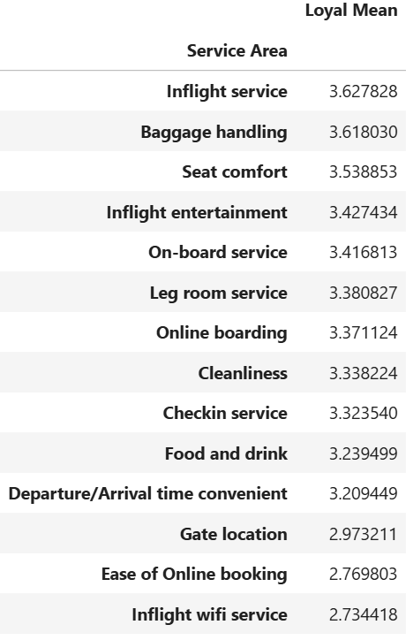
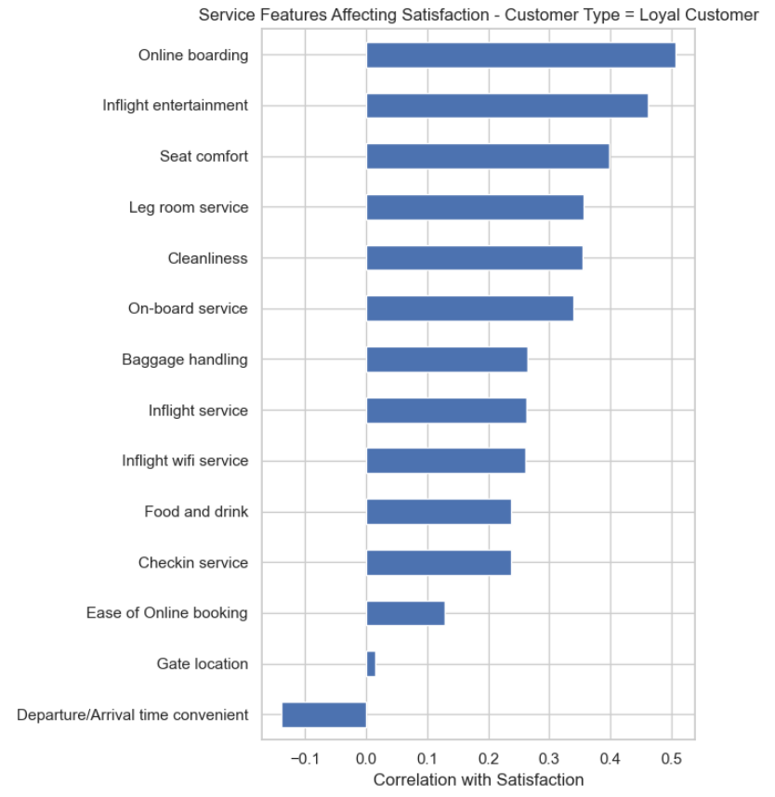
Data Analysis
Feature Importance by Customer Type - Loyal
Online boarding and inflight entertainment are the top satisfaction drivers → invest in digital experience
Seat comfort, leg room, and cleanliness show strong influence → comfort quality matters
Departure/arrival convenience has negative correlation → timing issues reduce satisfaction

Slide 29
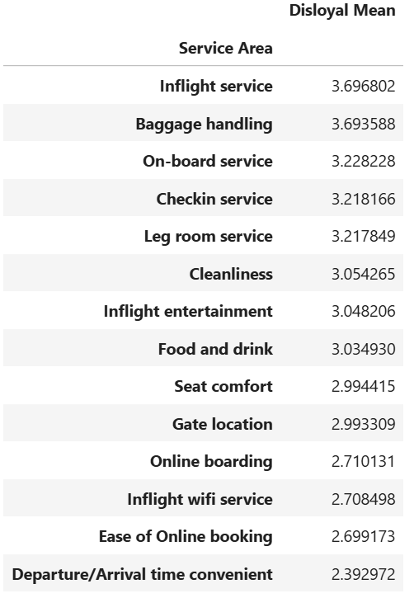
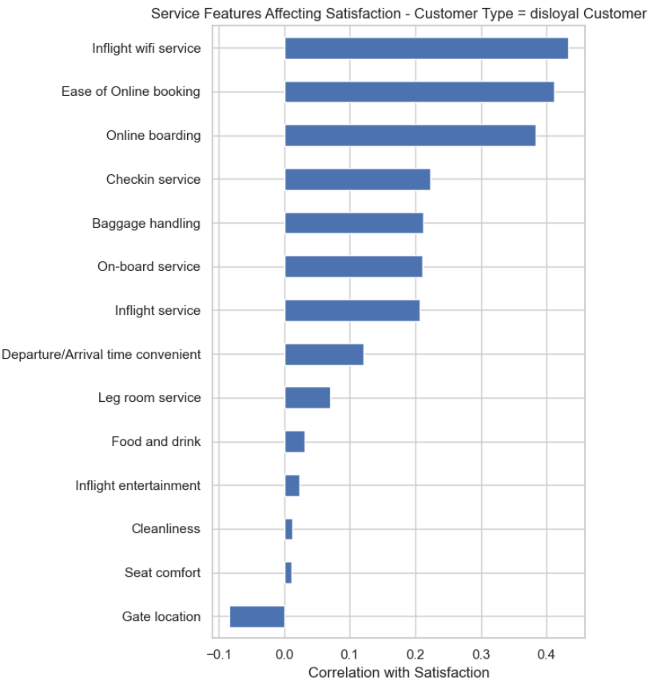
Data Analysis
Feature Importance by Customer Type - Disloyal
Inflight Wi-Fi is the top driver, meaning digital connectivity strongly influences satisfaction for disloyal customers
Gate location and arrival/departure timing have negative correlations, indicating these issues frustrate disloyal customers the most.
Overall mean scores are low–moderate, confirming that disloyal customers rate nearly all services lower.

Slide 30







Conclusion
Online Boarding is the most important service feature
Passengers are more dissatisfied at 56.7%
Cabin Class has the highest driver of Satisfaction
Delays in flights reduce overall satisfaction among passengers
Overall Service Area performance averages at 3.24 which is fairly acceptable but not high enough to impress passengers resulting to higher dissatisfaction
Business Class has high reaction to Online Boarding translating to satisfaction
Economy (Eco and Eco Plus) values Inflight Wifi Service the most
Business Class passengers are the most satisfied
Above 30 minutes delay increases dissatisfaction rate

Slide 31




Recommendation
Review Flight Delay data to reduce occurrence
Explore upgrading services for
Eco Class passengers
Improve/Add Loyalty perks to Loyal Customers
Promote Business Class and top-tier services
Possible data analysis can be implemented to review flight delay and possible recommendations
Response strategies used for business class during flight delays are effective—consider applying these proven solutions to economy passengers when delays are severe, to improve satisfaction
To improve satisfaction among Eco Class passengers, the airline should prioritize enhancing inflight Wi-Fi reliability, simplifying online boarding and booking processes
Maintain and enhance online boarding and inflight services to retain satisfaction among existing loyal business class customers
Introduce targeted loyalty incentives (point system) and service upgrades aimed at encouraging both economy passengers and non-loyal business travelers to become loyal business class customers
Loyal customers have lower satisfaction rates, which poses a risk since they are frequent flyers.
Offering extra benefits for online boarding and inflight entertainment can improve loyalty and retention among these valued passengers

Slide 32
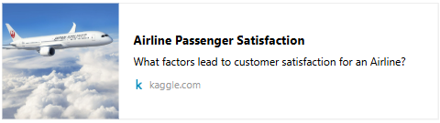

References
Airline Passenger Satisfaction
Research and Markets. (2024). Airlines in Canada. Research and Markets. https://www.researchandmarkets.com/report/canada-airline-market
CBC News. (2024, June 29). The new airline rivalries: Air Canada vs. Porter, WestJet vs. Flair. Canadian Broadcasting Corporation. https://www.cbc.ca/news/canada/montreal/airline-rivalries-air-canada-porter-westjet-flair-1.7251143

Slide 33
GROUP 8
THANK YOU!
John de Guzman
Elaine Bhel Lagman
Renee Rae Santos
Hazal Turken

